Slide 1
California’s System of Support and School Plan Development: Process and Timeline

Slide 2
California’s System of Support
Differentiated Assistance = Support for Districts
WJUSD
Comprehensive Support and Improvement = Support for Schools
Whitehead School
Additional Targeted Support and Improvement = Support for Schools
Maxwell School
Douglass Middle
Lee Middle

Slide 3
NEW for 2019 Plans
School Plan
New sections: Stakeholder Involvement, Metrics, Expected Outcomes, Budgeting – Estimated Actuals for Annual Update
New timeline: Must be approved before the District LCAP is approved
New process: Conduct a needs assessment with school/district team
Local Control and Accountability Plan
New sections: Comprehensive Support and Improvement, Budget Overview for Parents

Slide 4
School Plan for Student Achievement (SPSA) Development
Needs assessment process with school site teams
1
Data review using California School Dashboard
Root Cause Analysis
Developing Change Ideas (actions and strategies)
Principals engage with stakeholder groups
Staff Team, Leadership Team
School Site Council
English Learner Advisory Committee
2
Plan development, review, and approval
Draft to Educational Services by March 31
Review and Approval by SSC
Review and Approval by WJUSD Board of Trustees
3

Slide 5
Major Changes to the School Plan Template
Previous School Plan Template |  | Additions to New School Plan Template
Develop Budget and Actions for the Year | + | Report on Actual Expenditures and Completed Actions for the Year
Review and Analyze Data | + | Establish Metrics and Expected Outcomes for the Year
Approved by School Site Council and WJUSD Board of Trustees | + | Approved by California State Board of Education
New

Slide 6
Goals
Will be pre-populated in the School Plan
Same goals as the LCAP
Local Control and Accountability Plan (LCAP) Goals
1. All students will be proficient in literacy, numeracy, and 21st Century Skills through high quality, effective teaching and learning.
2. All students will graduate high school and be competitively college and career ready through personalized learning.
3. All students will be successful through the development of targeted and coherent systems of support.
4. Improve the English proficiency and academic achievement of English Learners.
5. Excellence for all students is supported through meaningful stakeholder engagement.

Slide 7
New
Metrics
Metrics = how the school will evaluate progress toward the goal
Baseline = current level of performance
Expected Outcome = progress the school intends to make in the coming year
Some metrics will be pre-populated for School Plans

Slide 8
Metrics Included in the School Plans
Examples
Show growth on the English Language Arts and Math Academic Indicator
Increase the number of students who are “Prepared” on the College/Career Indicator (high school only)
Decrease the number of students who are chronically absent
Increase student sense of safety and school connectedness

Slide 9
Metrics for CSI/ATSI Schools
CSI schools must include school-level metrics that relate to the metrics that led to the school’s identification.
ATSI schools must include metrics related to the specific student group(s) that led to the school’s identification.

Slide 10
Plan Requirements: Actions and Strategies
A description of the strategies that the school will be implementing to address school needs, including a description of how such strategies will—
Provide opportunities for all children including each of the subgroups of students to meet the challenging state academic standards
Use methods and instructional strategies that:
strengthen the academic program in the school,
increase the amount and quality of learning time, and
provide an enriched and accelerated curriculum, which may include programs, activities, and courses necessary to provide a well-rounded education
Address the needs of all children in the school, but particularly the needs of those at risk of not meeting the challenging State academic standards, so that all students demonstrate at least proficiency on the State’s academic standards through activities which may include:
strategies to improve students’ skills outside the academic subject areas;
preparation for and awareness of opportunities for postsecondary education and the workforce;
implementation of a schoolwide tiered model to prevent and address problem behavior;
professional development and other activities for teachers, paraprofessionals, and other school personnel to improve instruction and use of data; and
strategies for assisting preschool children in the transition from early childhood education programs to local elementary school programs.

Slide 11
Developing your own action/strategy
Steps
Identify the goal
Choose/develop your metric(s)
Describe your action/strategy
Plan for implementation
Plan for monitoring and evaluation
Plan for tracking expenditures

Slide 12
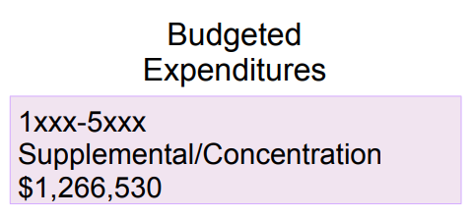
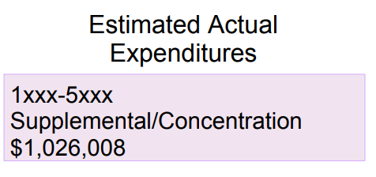
Example of Budgeted and Estimated Actual Expenditures
Goal 2: All students will graduate high school and be competitively college and career ready through personalized learning.
Implement rigorous and differentiated learning models to respond to the needs of diverse learners in preK - Adult Education and promote opportunities for reteaching, acceleration, and access to a broad course of study, including the following programs:
*Interdisciplinary UC a-g approved courses
*Integrated CTE
*Integrated VAPA
*Online learning
*Dual/concurrent enrollment
*Dual Immersion program expansion
*Ethnic Studies and Mariachi courses will be ready for board approval no later than January 25, 2018
New

Slide 13
Additions to the LCAP Template
New
New Sections
Schools Identified for Comprehensive Support and Improvement
How the District has supported the CSI school in developing a plan that includes a school-level needs assessment, evidence-based interventions, and the identification of any resource inequities
How the District will monitor and evaluate the implementation and effectiveness of the CSI plan to support student and school improvement.
Budget Overview for Parents

Slide 14
Root Cause Analysis
The goal of root cause analysis to get a deeper understanding of the problem we want to address.
Norms
Avoid “solutionitis” = the goal is to understand the issue, not solve it (yet)
“Yes and” = the goal is to generate lots of ideas, and not fixate on one
Embrace uncertainty
Share the air

Slide 15
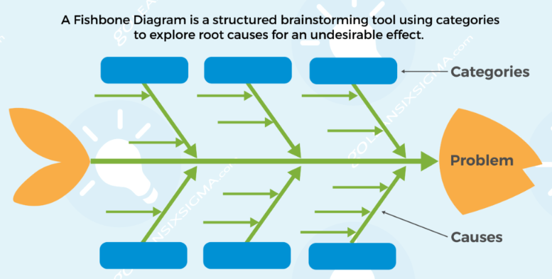
Example Fishbone

Slide 17
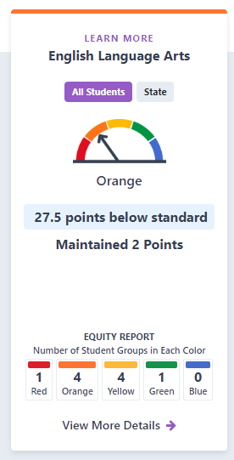
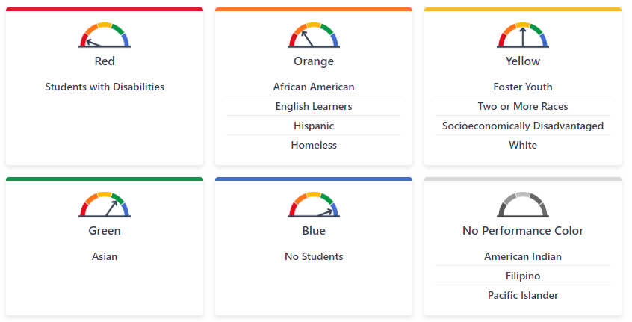
overall
Student Group Performance

Slide 18
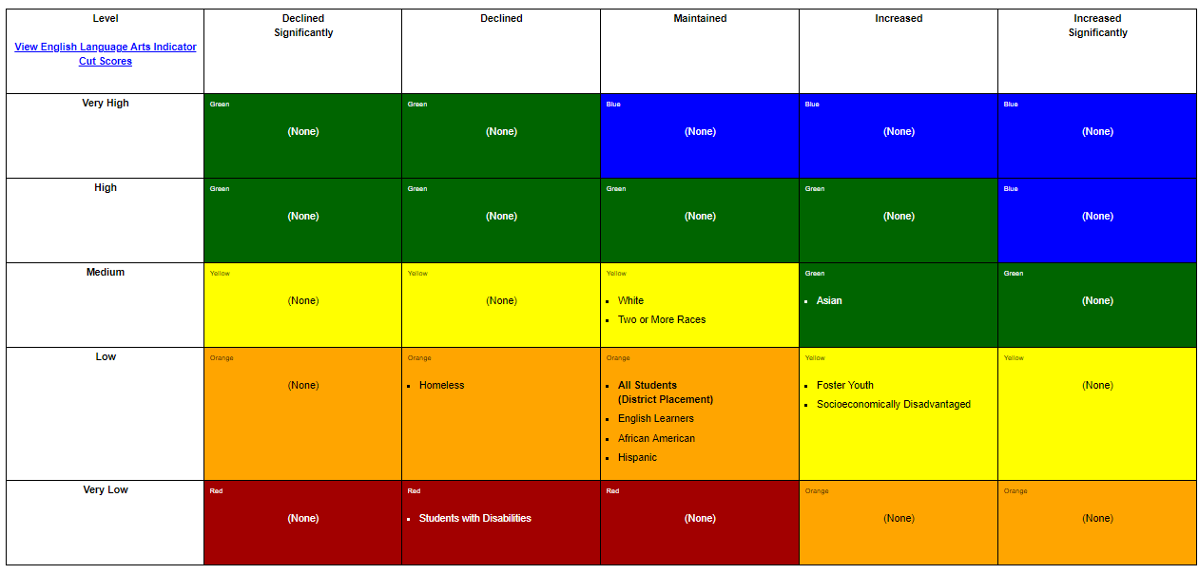
English Language Arts Placement Report

Slide 19
Root Cause Analysis
Steps:
Identify the Problem
Low Achievement in English Language Arts
Brainstorm Causes: Individually brainstorm as many causes as you can that might contribute to the problem/issue. Write each cause on a different post-it.
Share and Categorize: Each person shares one cause contributing to the problem. Place on the fishbone, and continue to share ideas. Group related causes together into categories and label.
Post and Reflect: Which factor do you think would have a significant impact?

Slide 20
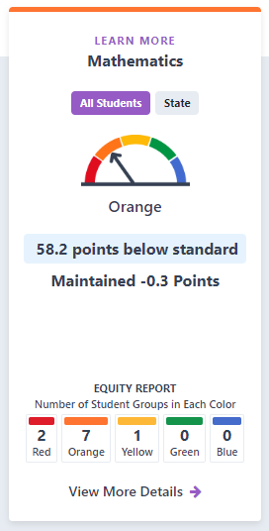
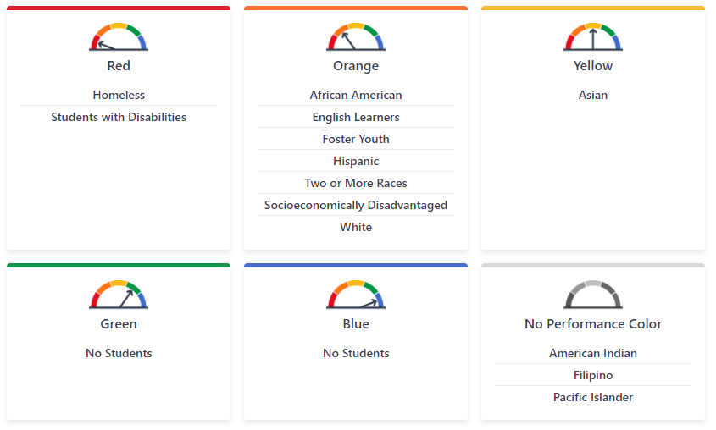
overall
Student Group Performance

Slide 21
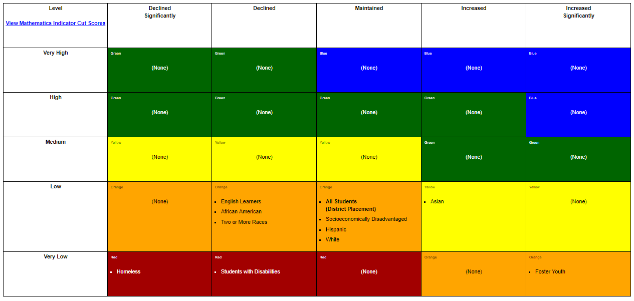
Math Placement Report

Slide 22
Next Steps in LCAP Process
Annual Survey – release survey on March 18 to solicit input from community and review results at April meeting
Annual Update – review draft at April meeting
Draft of LCAP – review draft at May meeting
Approval of LCAP – board meeting on June 27, 2019

